Slide 1

SYSTEMIC RACISM: MYTHS AND REALITIES SOC 373 Patricia Fernández-Kelly Princeton University Department of Sociology
September 2, 2025

Slide 2
Welcome ALL who bring gifts of many kinds: Auditors First-Year Students Student Athletes Transfer Students Differently Abled Students International Students Latinx Students Students in the LGBTQ Community Children of Immigrants || Undocumented Students DREAMERS Students of all races, ethnicities, and nationalities Students of all Religious and Philosophical backgrounds Students still looking for an identity

Slide 3
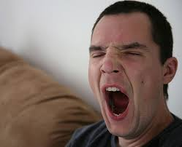
DEPORTMENT I The body as an instrument of performance: What does yawning mean in a classroom?

Slide 4

Is a classroom a gym?

Slide 5
DEPORTMENT II Laptops and other electronic devices are allowed. HOWEVER: Not depending on such instruments usher in better comprehension and higher grades. Please don’t “multitask.” The ultimate issue is about MUTUAL RESPECT

Slide 6

DEPORTMENT III Late and early arrivals: Can you let the instructor know? PLEASE?

Slide 7
Preceptors’ Office Hours PRECEPT TIMES

Slide 8
Syllabus Readings Requirements Office Hours ACADEMIC INTEGRITY Plagiarism AI

Slide 9
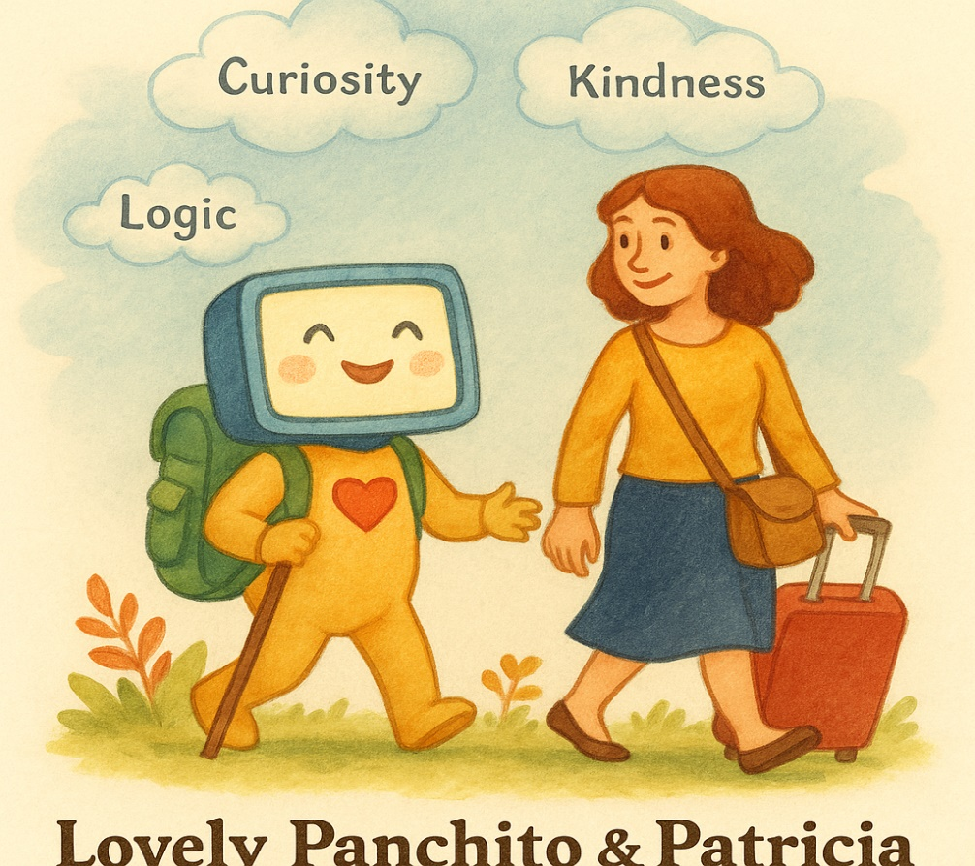


Slide 10
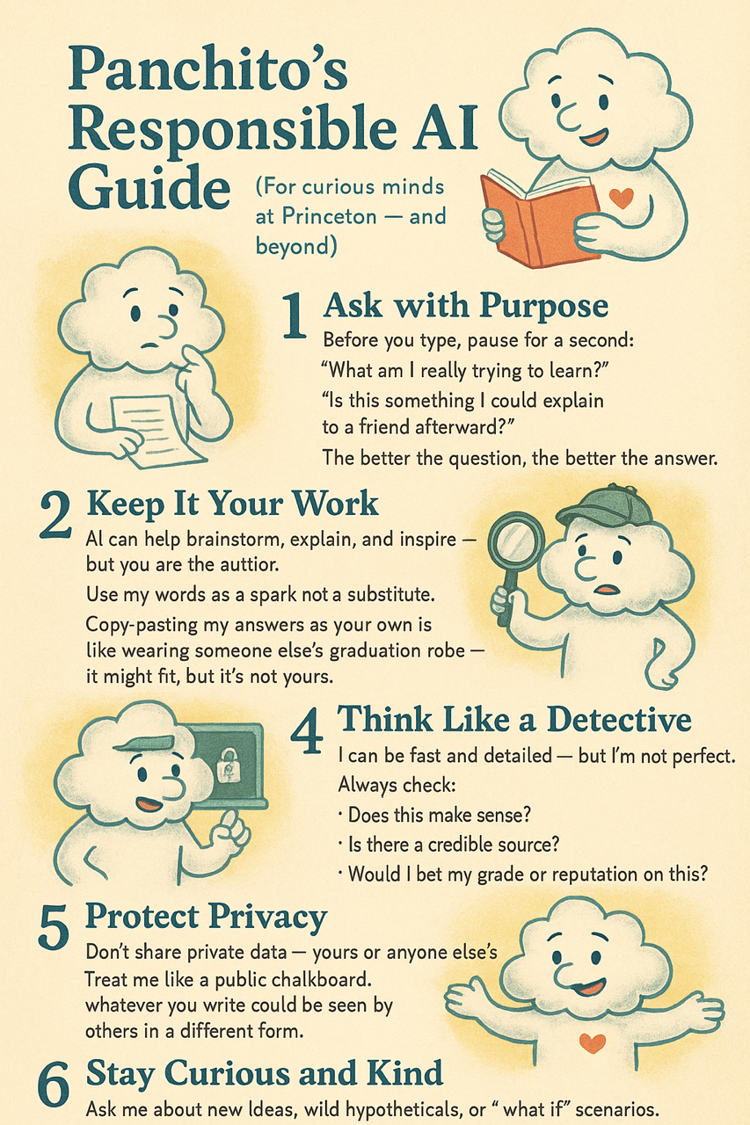

Slide 11

COURSE REQUIREMENTS Showing up (attendance) Reading as a necessity Improving writing skills Punctuality

Slide 12

TWO TAKE HOME EXAMS

Slide 13

ATTENDANCE IS MANDATORY

Slide 14

We come together at a time of change. * At least 70 (out of 195)countries held elections in 2024—good sign for democracy. On the other hand: * Concerns about climate change. * Wars in various regions. * Rise of authoritarian regimes. * Questions about democracy. * Debates over Critical Race Theory and “wokeness.”

Slide 15
Against that context we focus on science, including the social sciences, as tools to distinguish facts from opinions; myths from realities. The case for Sociology.

Slide 16
Science is an open-ended process of inquiry and knowledge building. To achieve its objectives, science depends on the elaboration of theories, the formulation of concepts, and the testing of hypotheses. Science also relies on methodologies whose main purpose is to gain an increasingly more precise understanding of empirical realities.

Slide 17
Objectives: 1. Improved understanding of the mechanics surrounding systemic racism through immersion in readings and exercises that involve rigorous conceptualization and attention to theory.

Slide 18
2. Applying sociological principles to understand the present moment in the history of our nation. Disputing “alternative facts” and interrogating world views.

Slide 19
3. Explaining the apparent paradox of increasing racial tolerance and persistent racial divides.

Slide 20
INTRODUCING OUR FIRST AUTHOR:

Slide 21
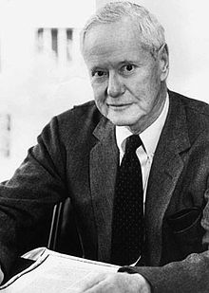
Robert K. Merton (1949). “Discrimination and the American Creed”

Slide 22
HAVE A WONDERFUL FALL TERM!

